Slide 1

Securing the Future — Penetration Testing Ubuntu Touch
FOSS Fest September 2025 - National Hackathon
Team Fusion Techno
Mokshayini D R
Monisha D
Sinchana Ravi Gowda
Sneha D P

Slide 2
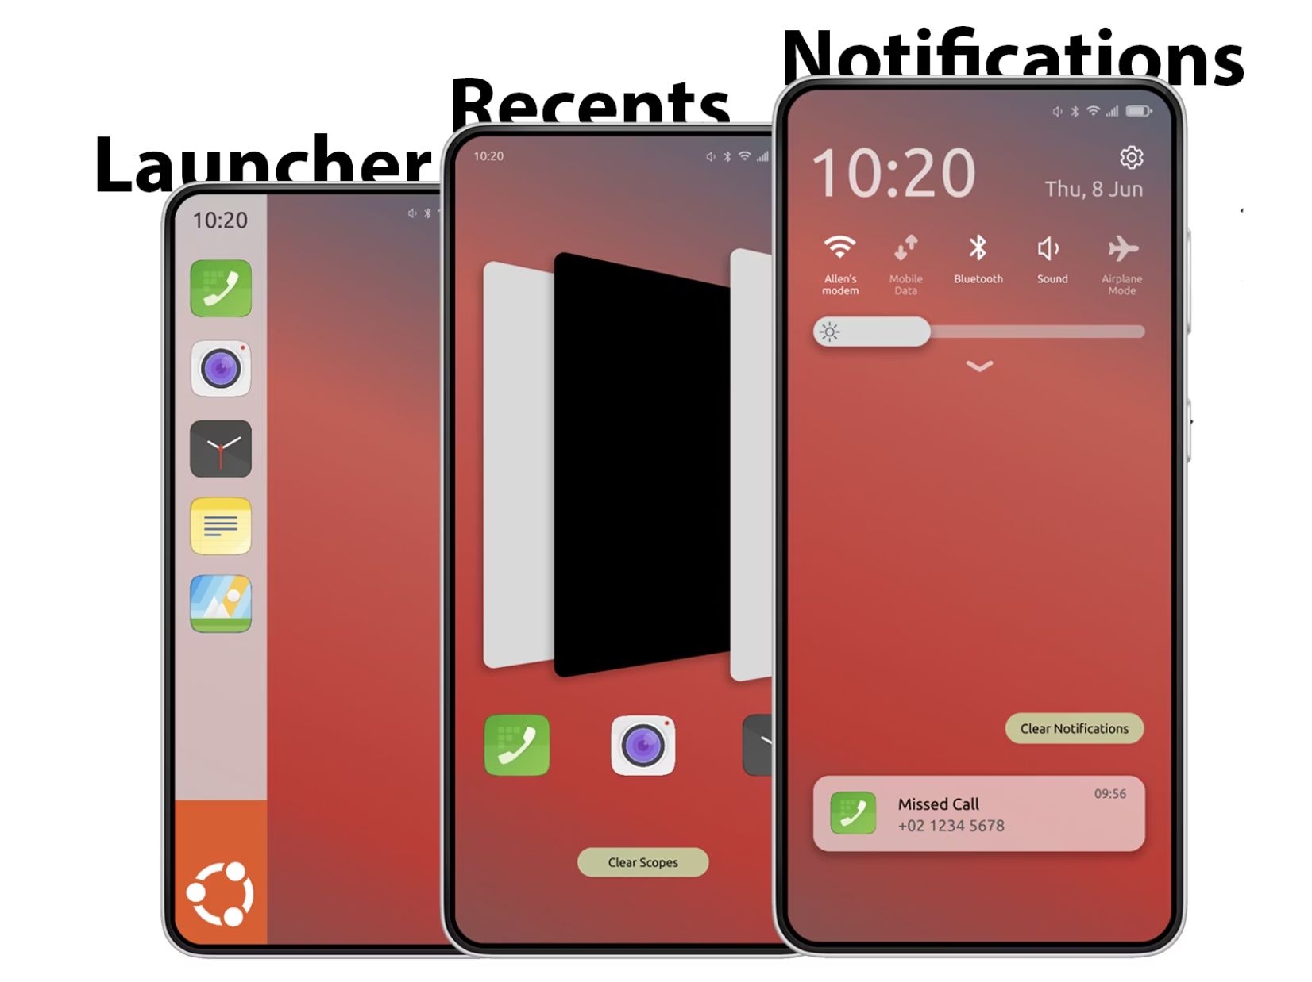
The Challenge
Ubuntu Touch: Privacy-First Computing
The open-source mobile OS promises security and privacy. But in a world of increasing cyber threats, how secure is it really?
Today we present our comprehensive penetration testing analysis that simulates real-world attacks to uncover vulnerabilities and strengthen Ubuntu Touch's security posture.

Slide 3

Mission Statement
Simulate Real Attacks
Identify Vulnerabilities
Execute authentic penetration testing scenarios against Ubuntu Touch systems
Discover security gaps, exploits, and system-level flaws that could compromise user data
Strengthen Security
Provide actionable recommendations to enhance Ubuntu Touch's defensive capabilities

Slide 4

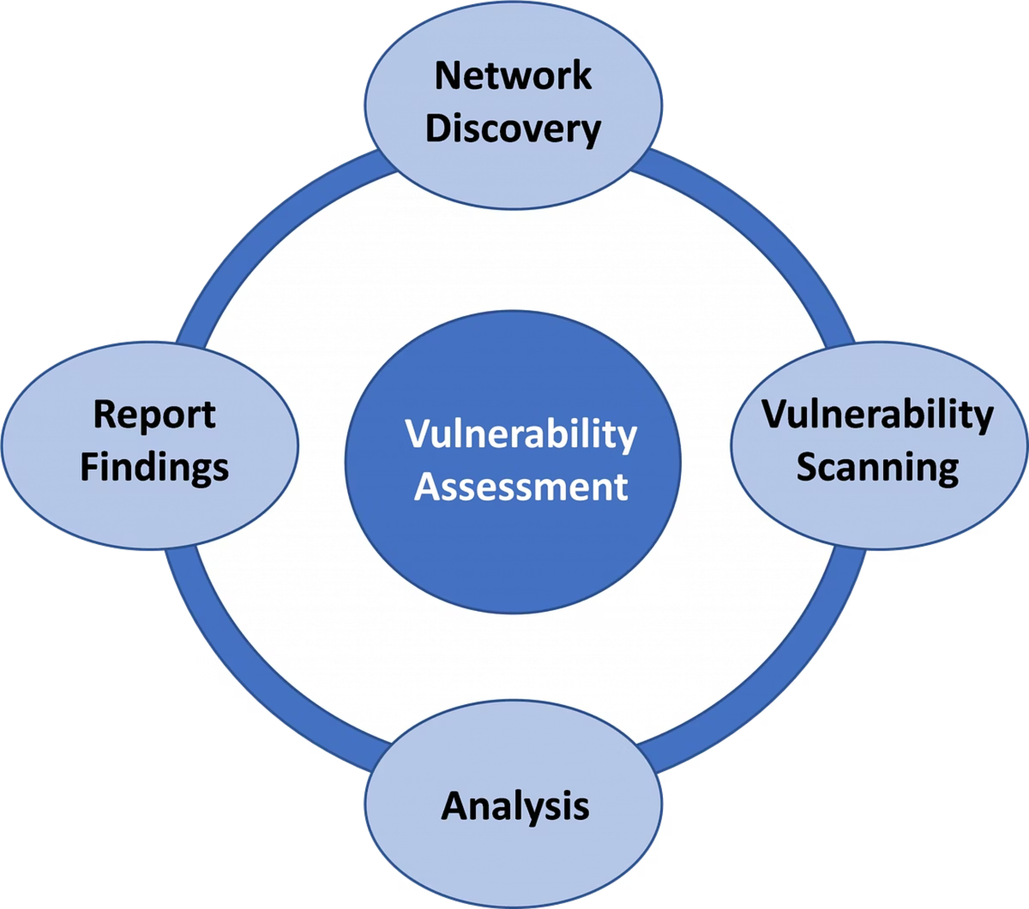
Testing Scope & Boundaries
In Scope
System-level security flaws
Application security vulnerabilities
Authentication bypass methods
Network protocol weaknesses
Physical access attack vectors
Out of Scope
Hardware-level destructive attacks
Device bricking or permanent damage
Social engineering campaigns
Third-party service vulnerabilities

Slide 5

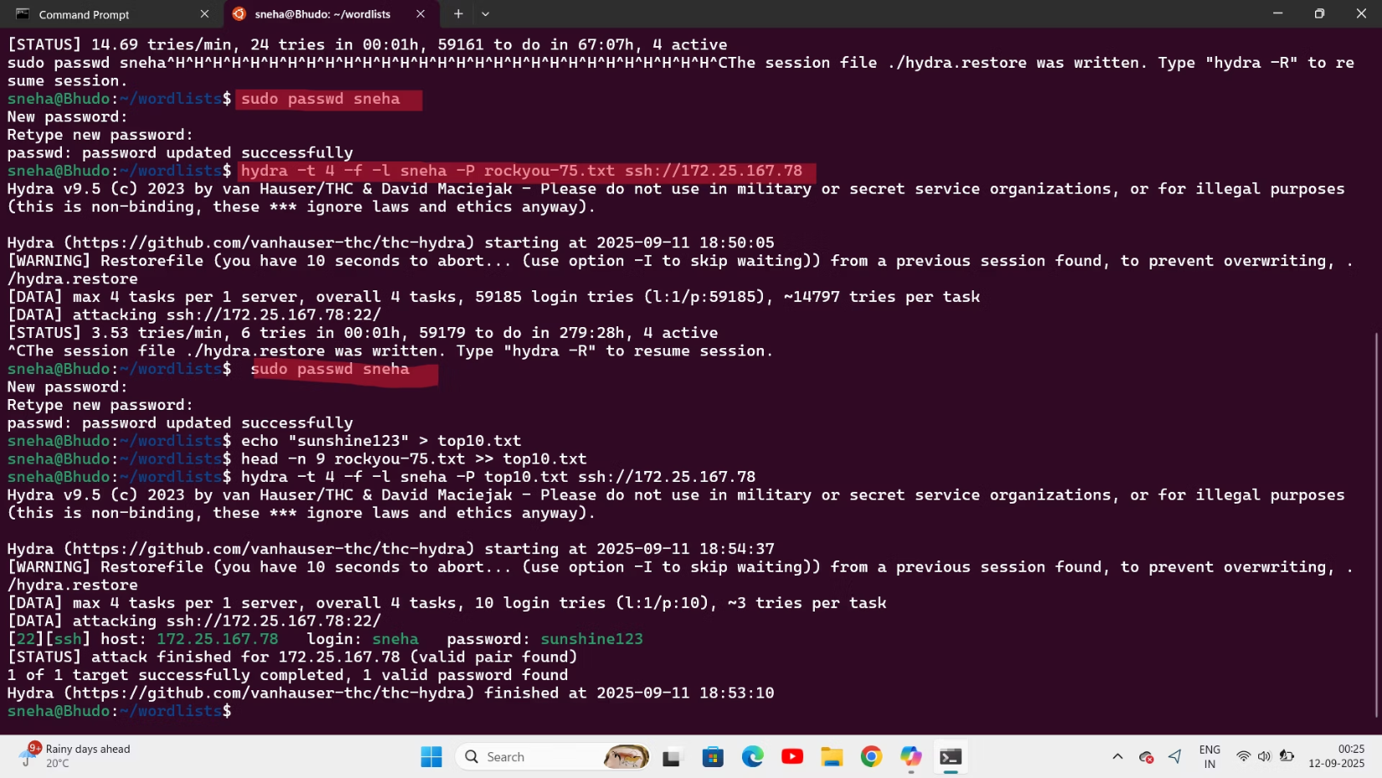


Our Testing Arsenal
We employed industry-standard penetration testing tools combined with custom-developed scripts to comprehensively assess Ubuntu Touch's security landscape.
ADB Tools
Android Debug Bridge for system access and debugging
AppArmor Analyzers
Security policy assessment and confinement bypass testing
Custom Scripts
Python-based exploitation tools and automated testing frameworks

Slide 6




Five-Phase Methodology
Reconnaissance
System enumeration, kernel analysis, and application discovery to map the attack surface
Vulnerability Assessment
Scanning for misconfigurations, weak permissions, and default credentials across the system
Exploitation
Active testing of discovered vulnerabilities with proof-of-concept attacks
Post-Exploitation
Privilege escalation attempts and persistence mechanism evaluation

Slide 7

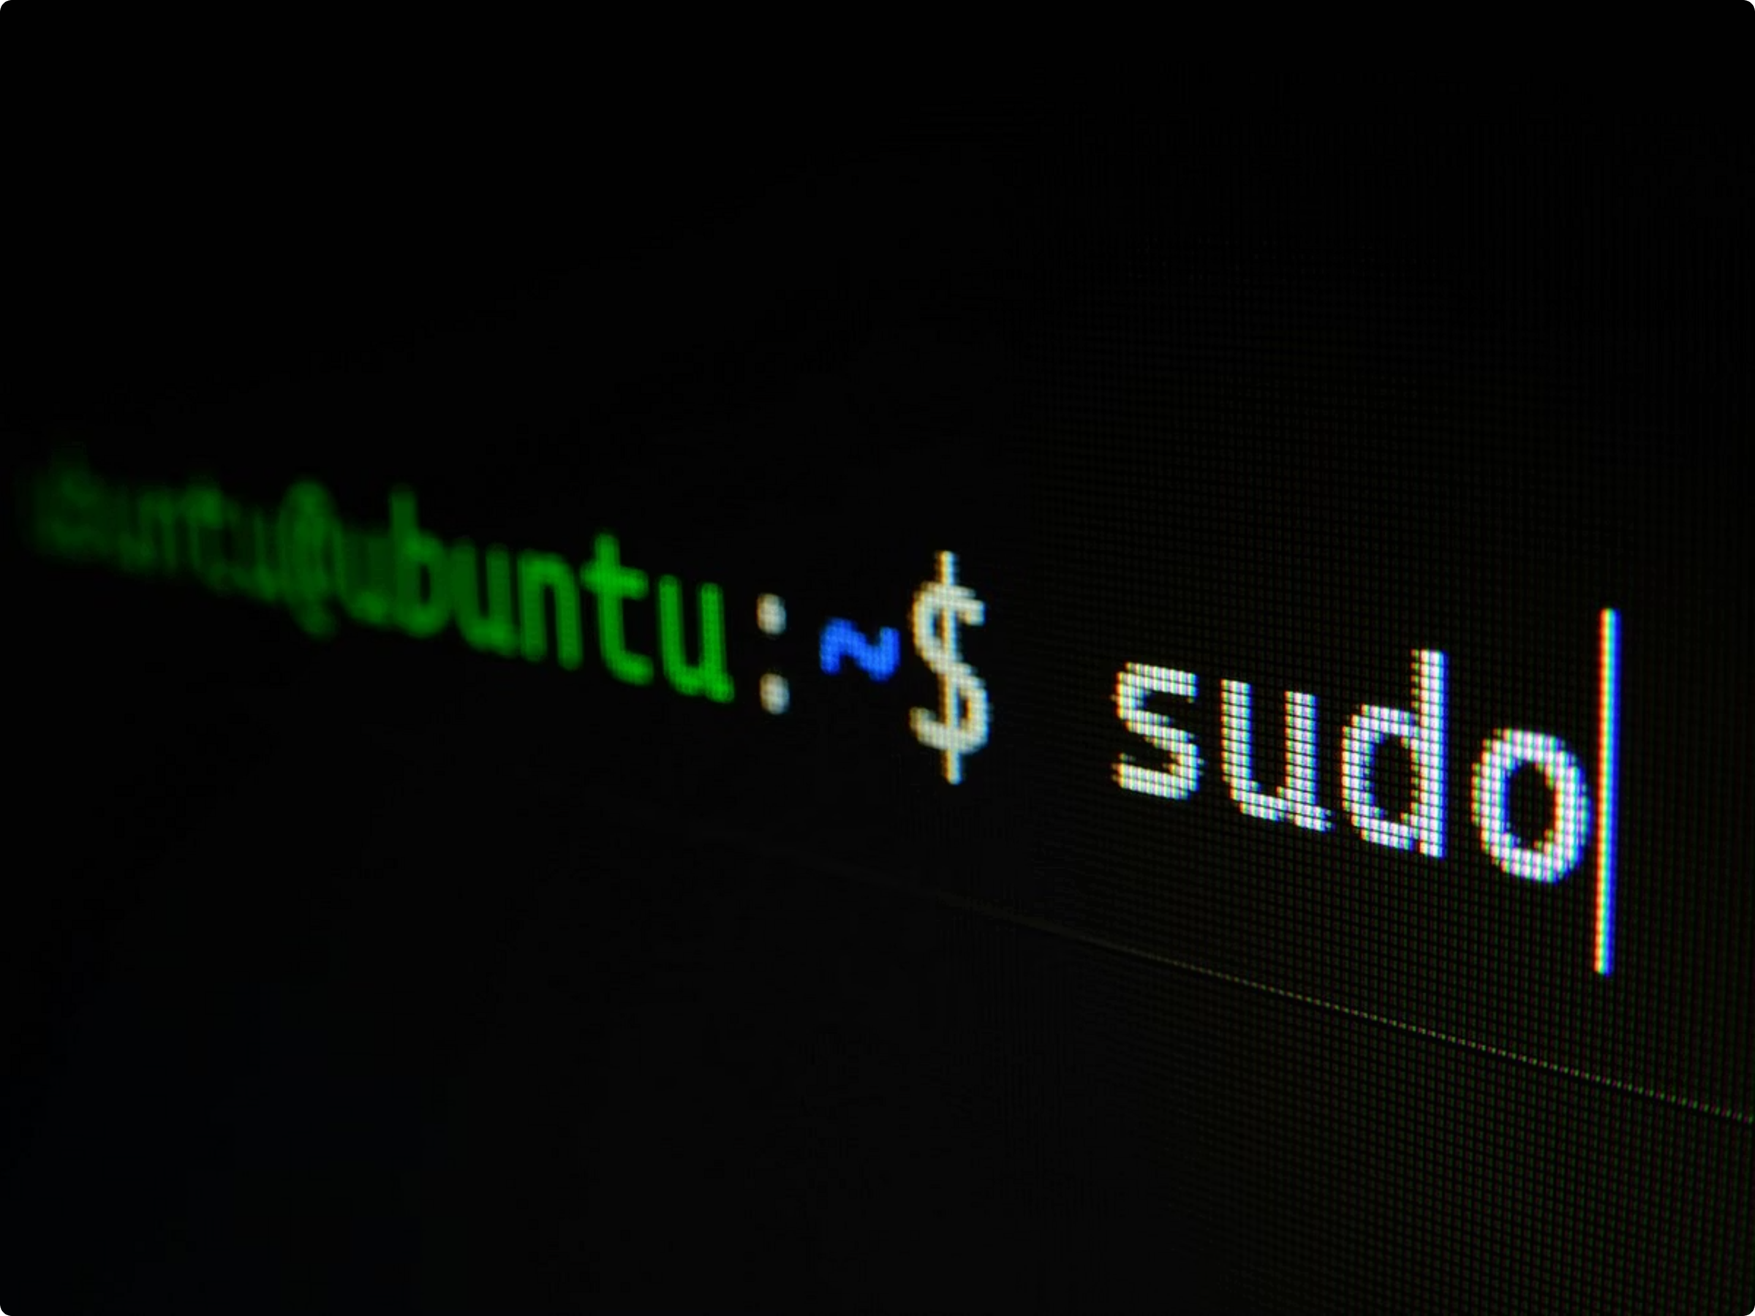




Critical Vulnerabilities Discovered
AppArmor Bypass
Sudo Pincode Compromise
Successfully circumvented security confinement policies, allowing unauthorized system access
Brute-forced 4-digit authentication mechanism within acceptable time constraints
Privilege Escalation
Exploited Wall-Escape and Dirty Pipe vulnerabilities to gain root-level system control
These findings represent critical security risks that require immediate attention from the UBports development team.

Slide 8
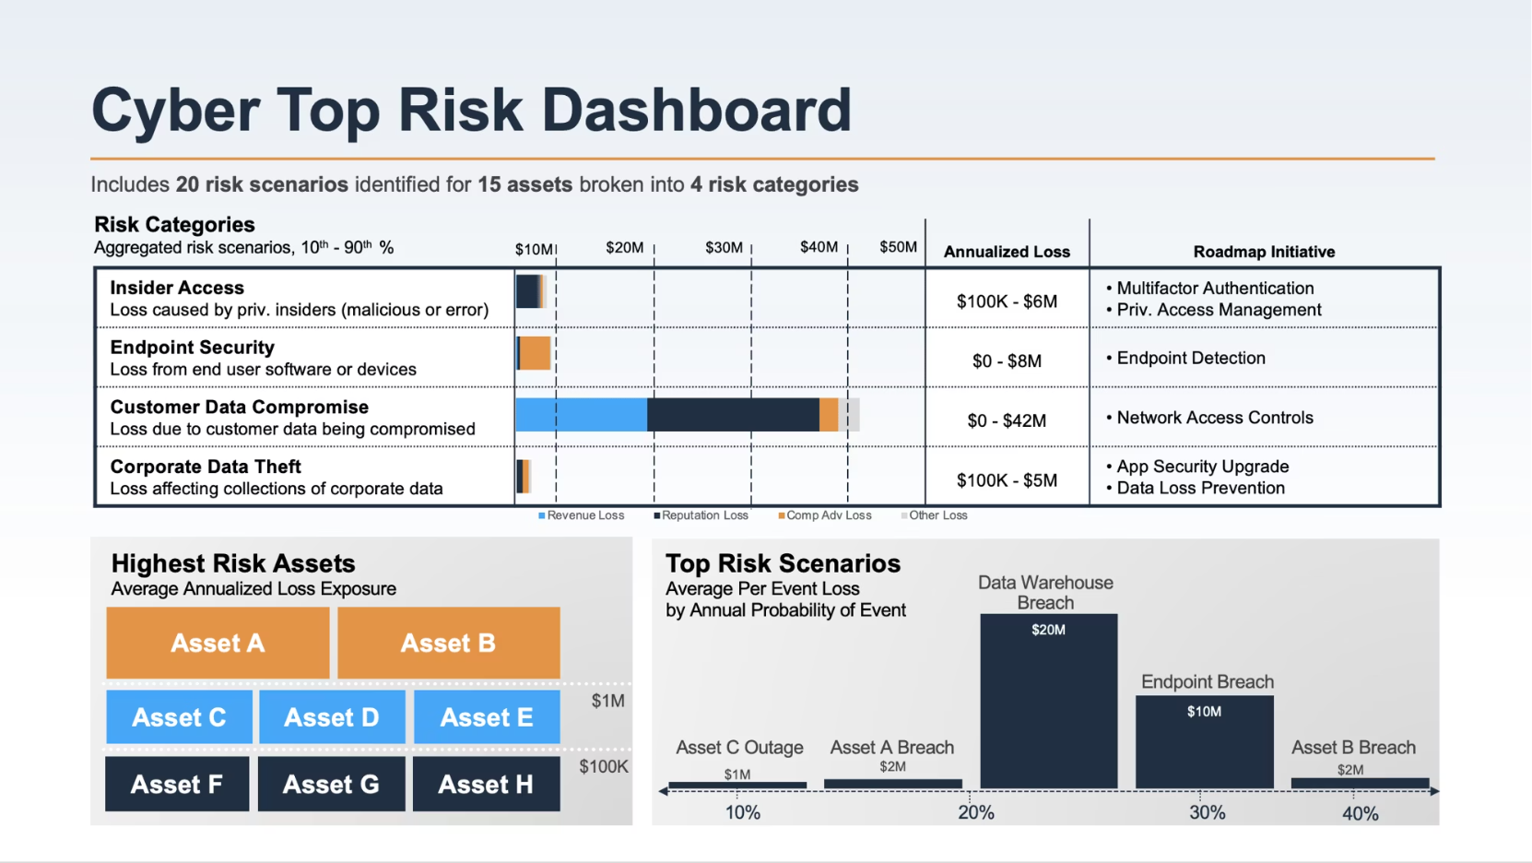
Security Impact Assessment
7
12
Critical Vulnerabilities
Medium Risk Issues
High-severity security flaws requiring immediate patching
Configuration weaknesses and potential attack vectors
100%
Primary Risks Identified
System Compromise
Unauthorized data access and extraction
System integrity compromise
Full device control achieved through exploit chain
Privacy policy violations
Persistent backdoor installation

Slide 9
Recommended Security Enhancements
01
02
03
Patch Vulnerable Binaries
Strengthen AppArmor Policies
Enhanced Authentication
Update system components affected by Wall-Escape and Dirty Pipe exploits to latest secure versions
Implement stricter confinement rules and eliminate policy bypass opportunities
Replace 4-digit PINs with complex passwords or biometric authentication methods
04
05
Network Security Hardening
Recovery Mode Protection
Implement encrypted communication protocols and traffic monitoring systems
Add authentication requirements for accessing system recovery and debugging modes

Slide 10








Ethical Testing & Future Collaboration
Responsible Disclosure
Community Collaboration
All vulnerabilities reported directly to UBports development team with detailed remediation guidance
Shared tools and methodologies with fellow teams to elevate overall security standards
Full Transparency
No Harm Principle
Complete documentation and proof-of-concept evidence available for community review
Zero device damage or data destruction - focused purely on constructive security improvement
Together, we're building a more secure open-source mobile ecosystem for everyone.

